Slide 1










Global & Economic Population Analysis
by
KARAN S

Slide 2



INTRODUCTION
This project aims to analyze and visualize global economic and demographic trends using data from multiple sources, including SQL and Excel files. The datasets cover key indicators such as population, GDP, literacy, health, and sectoral contributions across countries

Slide 3
DATA CLEANING
Remove duplicate values
Remove null and empty values
Remove unnecessary column
Rename the column
Handling the Missing values

Slide 4


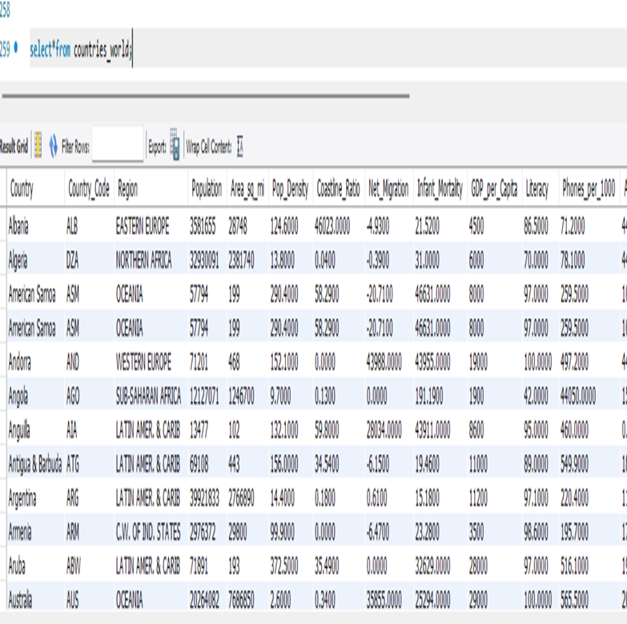
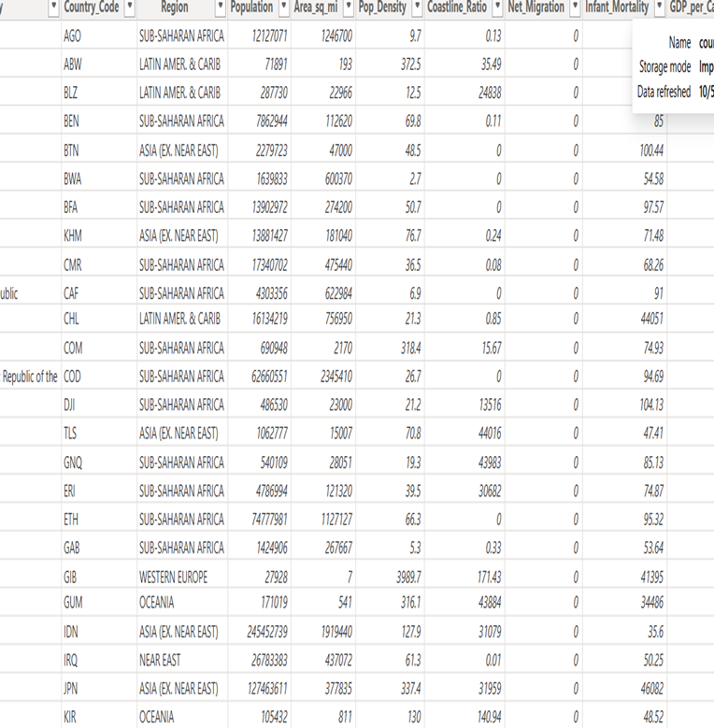

Slide 5
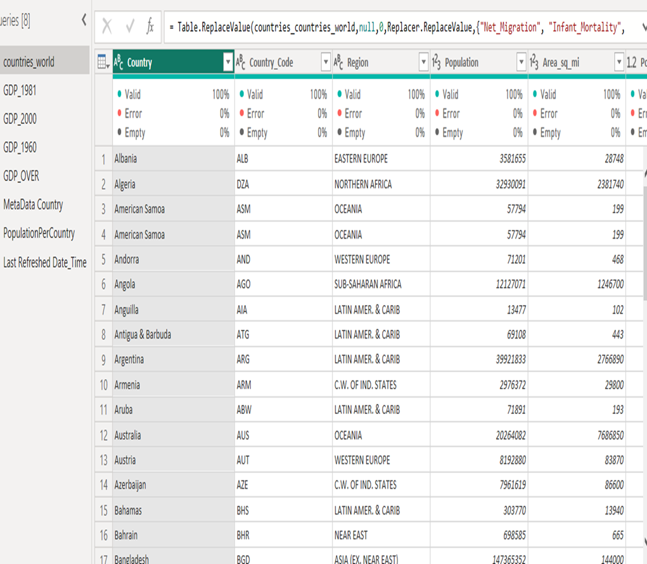
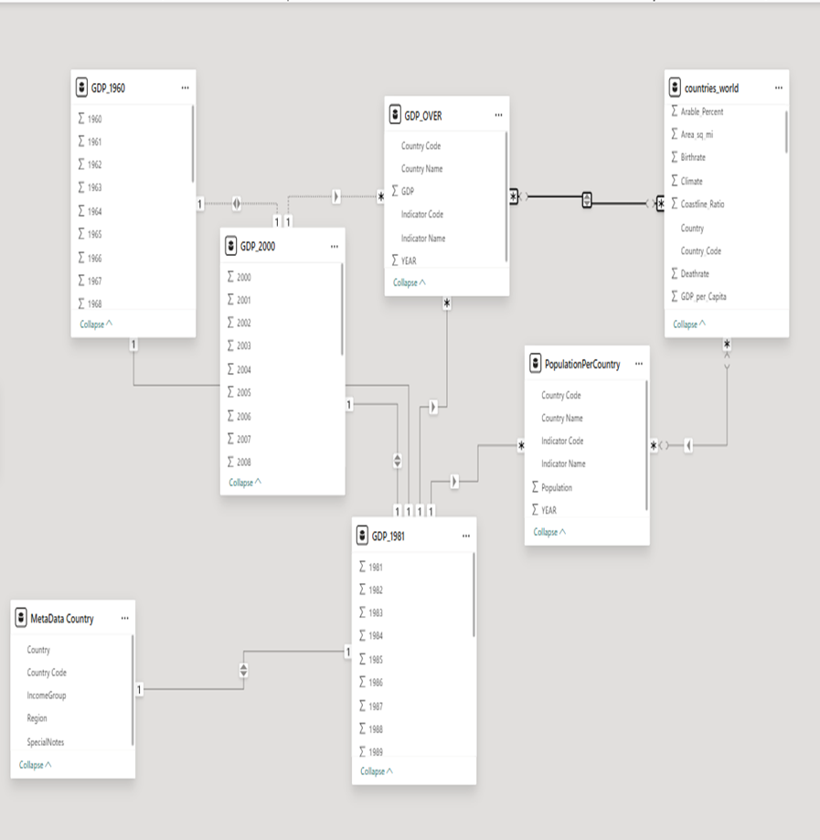

Slide 6
DASHBOARD

Slide 7
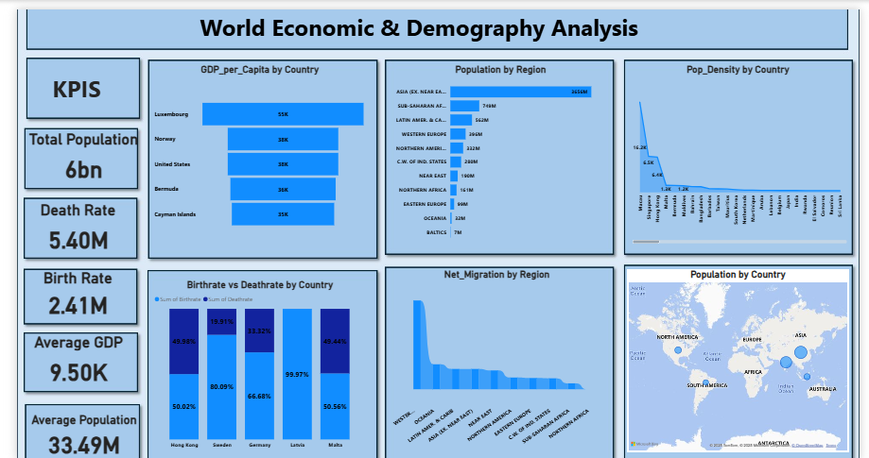

Slide 8
CONCLUSION
The population dashboard provides a comprehensive overview of global demographic dynamics, showcasing steady growth in population alongside improvements in literacy, life expectancy, and economic performance.
The insights highlight that while many countries are progressing toward sustainable development, disparities still exist between developed and developing regions.

Slide 9
THANK YOU

